Slide 1
Bioinformatics
Molecular Techniques

Slide 2
What is the smallest step you can do to be called a ‘Bioinformatician’ (or any other field)?

Slide 3
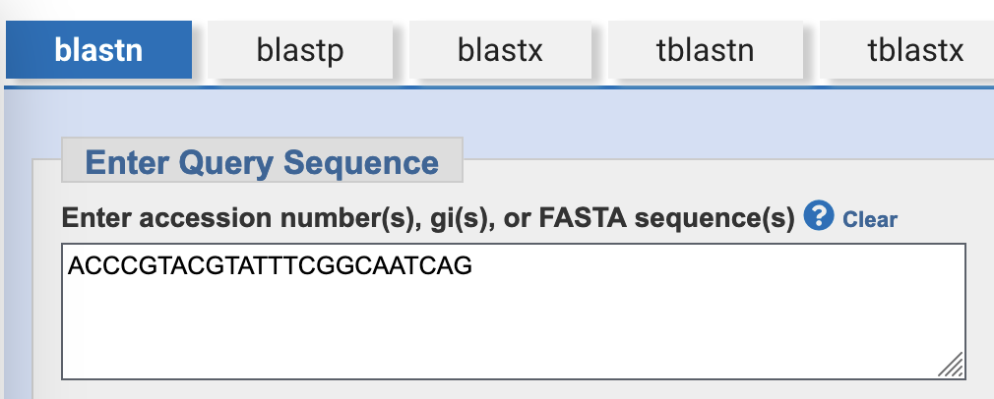
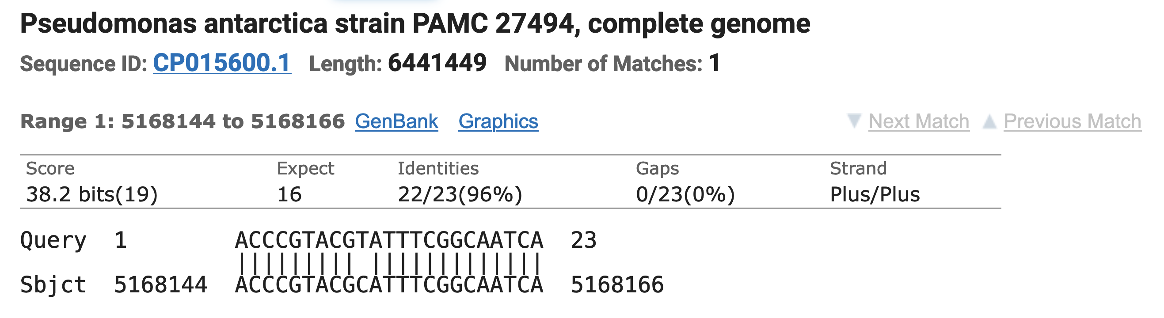
Matching a sequence of letters to another
https://blast.ncbi.nlm.nih.gov/Blast.cgi

Slide 4
Matching sequences across species

Slide 5
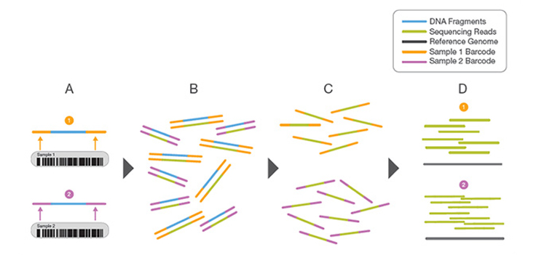
Multiplexing
https://www.illumina.com/techniques/sequencing/ngs-library-prep/multiplexing.html

Slide 6
Raw sequencing data
@SRR001666.1 071112_SLXA-EAS1_s_7:5:1:817:345 length=36
GGGTGATGGCCGCTGCCGATGGCGTCNAATCCCACC
+
IIIIIIIIIIIIIIIIIIIIIIIIIIIIII9IG9IC
@SRR001666.2 071112_SLXA-EAS1_s_7:5:1:801:338 length=36
GTTCAGGGATACGACGTTTGTATTTTAAGAATCTGA
+
IIIIIIIIIIIIIIIIIIIIIIIIIIIIIIII6IBI

Slide 7
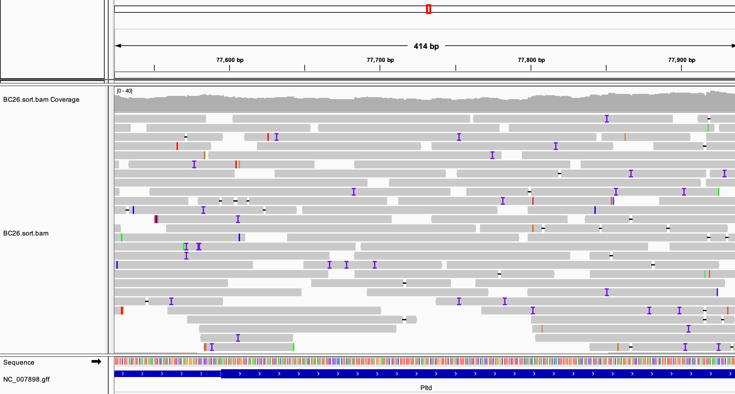
Matching reads to a reference
https://blast.ncbi.nlm.nih.gov/Blast.cgi

Slide 8
Genetics
DNA

Slide 9
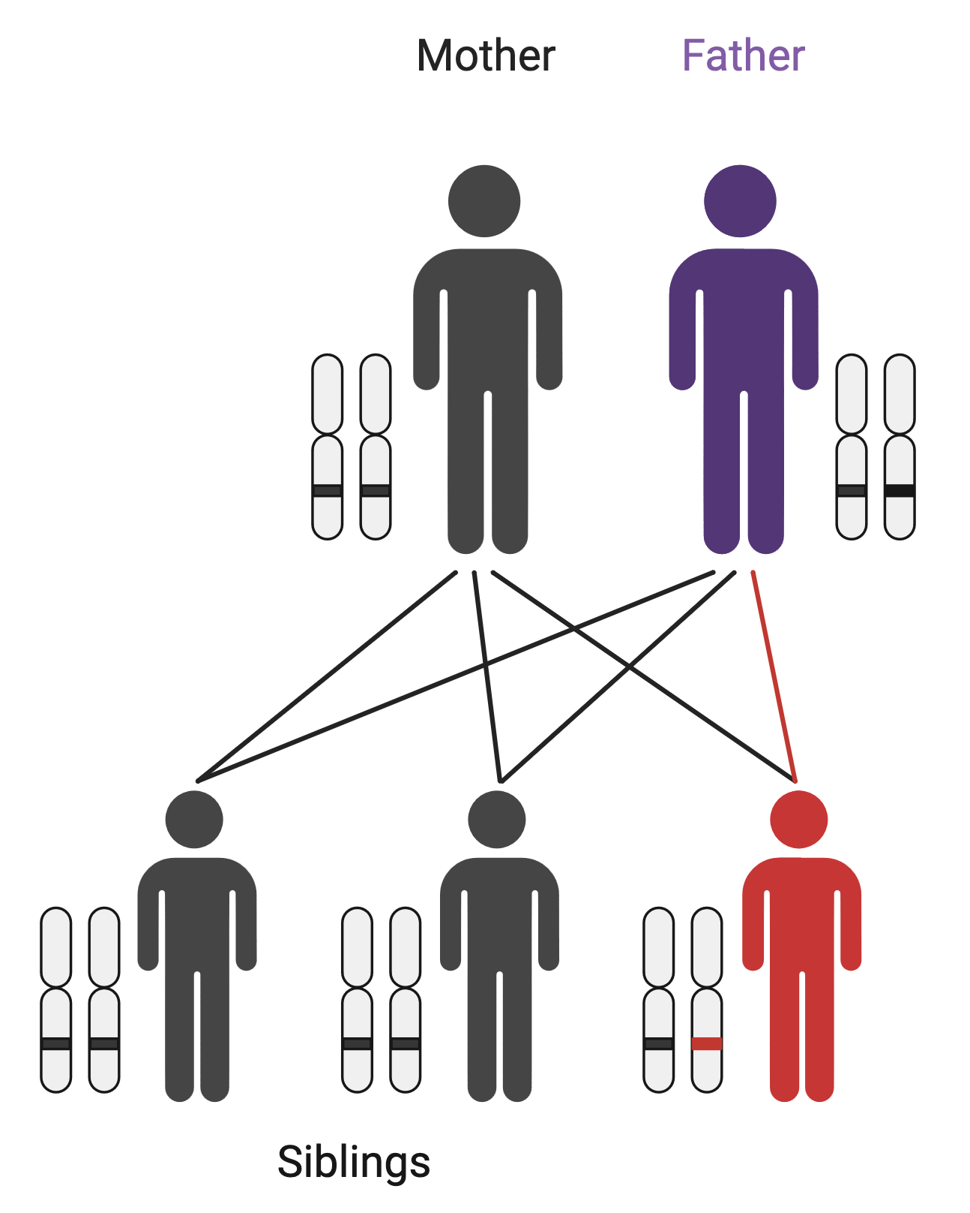

Rare diseases – de novo mutations
Mother: ATTCG
Father: ATTCG
Child: ATTGG
Sibling: ATTCG

Slide 10
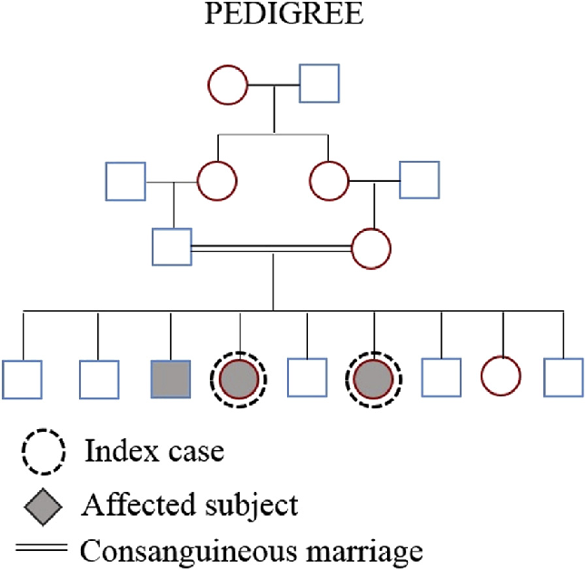
Rare diseases – consanguinity
Soares, D. et al. (2016). Pyle disease (metaphyseal dysplasia) presenting in two adult sisters. Radiology Case Reports. 11. 10.1016/j.radcr.2016.10.003.

Slide 11
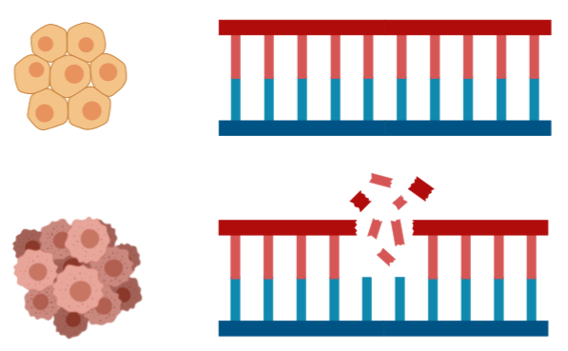

Cancer genetics
Sequence tumour sample and normal sample from the same patient.
Normal: GCTTAGCT
Cancer: GC_ _ _GCT

Slide 12
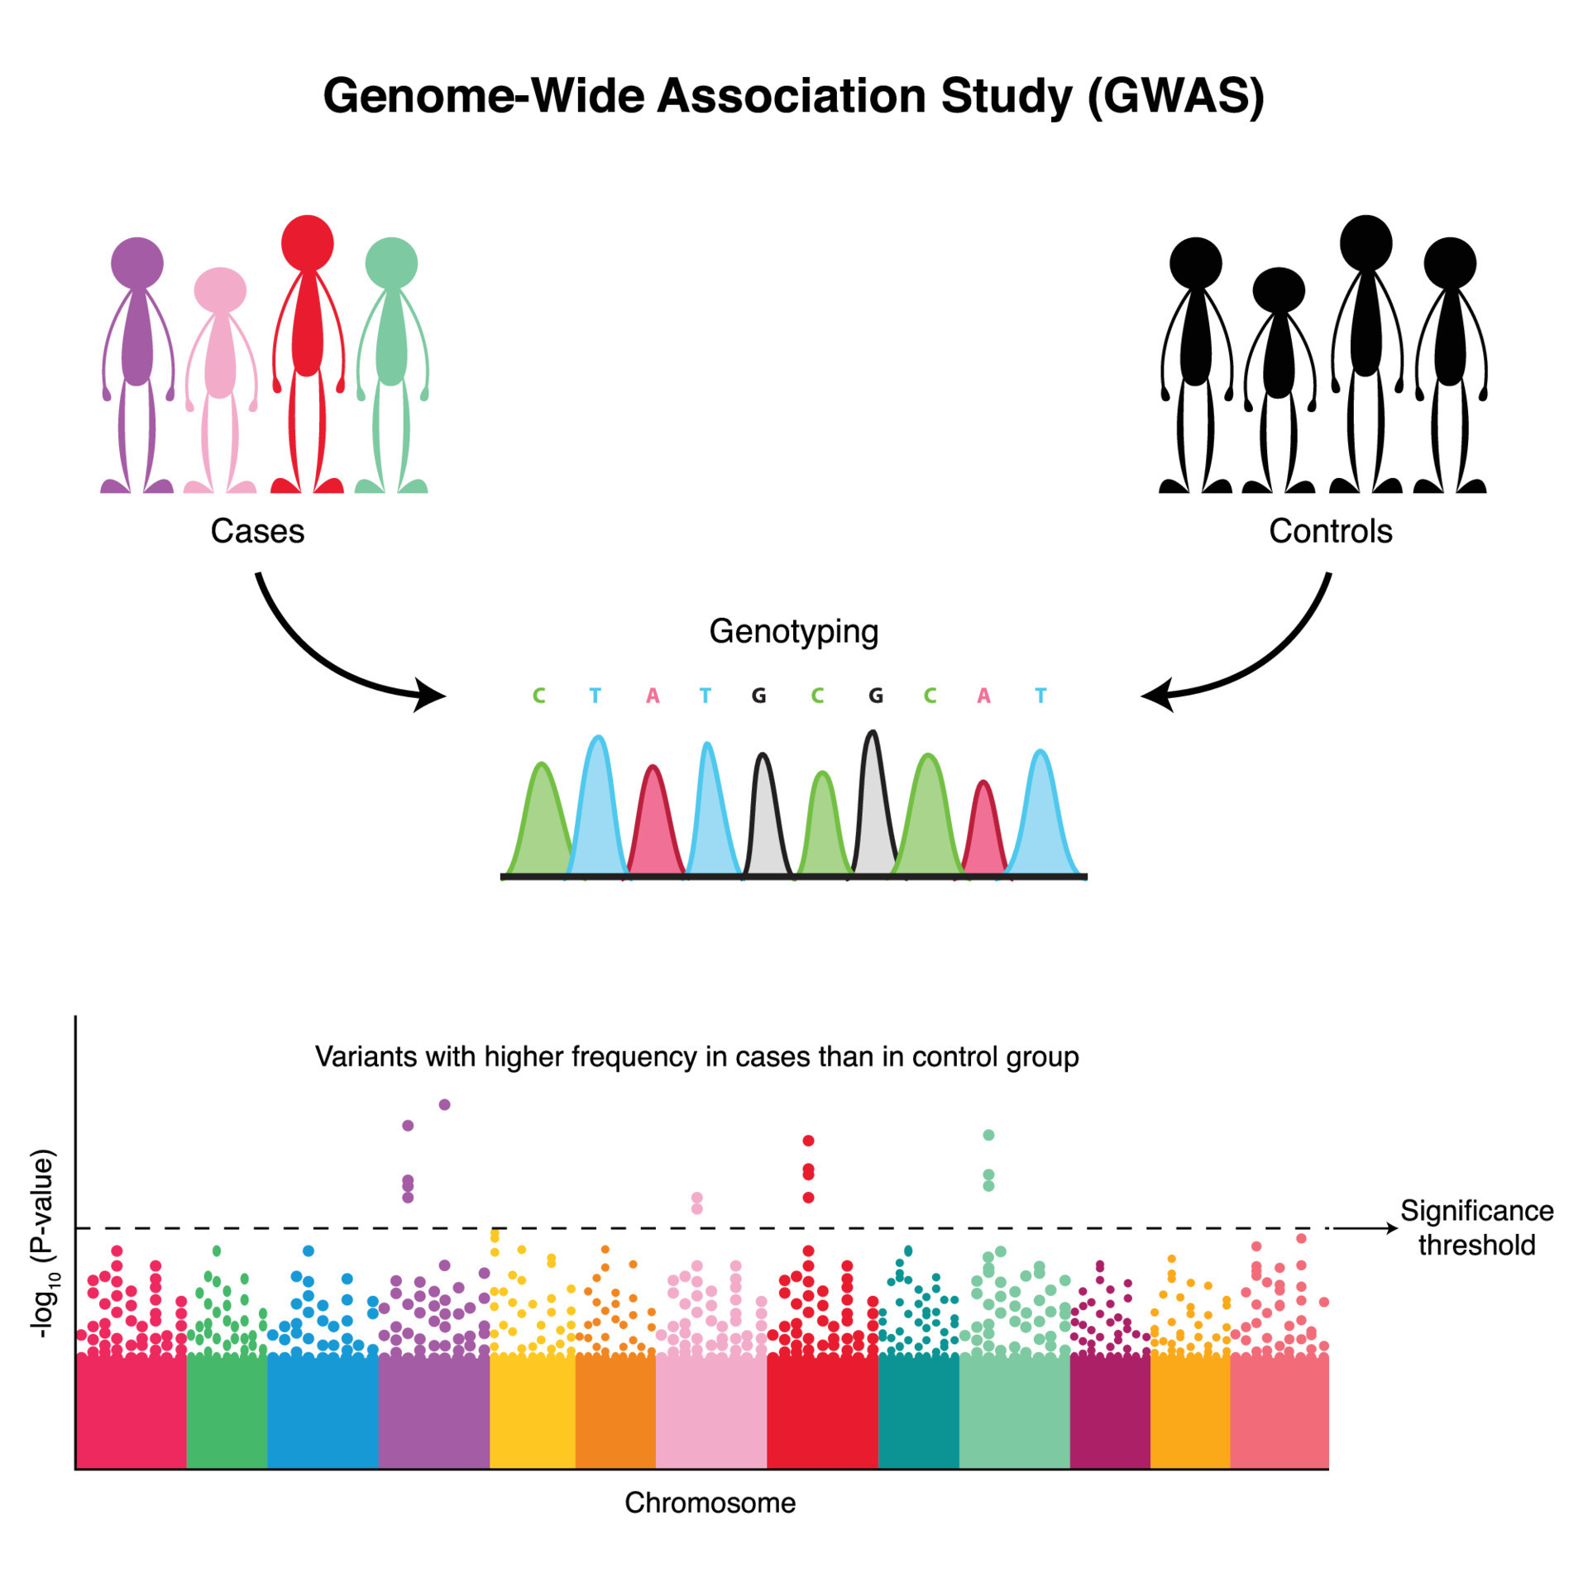
Complex traits / Common diseases
https://www.vecteezy.com/vector-art/7508599-genome-wide-association-study-diagram

Slide 13
DNA-sequencing methods compared
Feature | Genotyping | Sanger Sequencing | Next-Generation Sequencing (NGS) | Long-Read Sequencing
Throughput | Low (limited number of variants) | Low (one sequence at a time) | High (whole genome, exome, or targeted regions) | High (whole genome, longer reads)
Read Length | N/A (focuses on known variants) | ~500-1,000 bp | Short reads (~100-300 bp) | Long reads (~10,000-100,000+ bp)
Quantification | Relative allele frequency | Absolute sequence determination | Quantitative (read counts) | Quantitative (read counts)
Novel Variant Detection | No (only known variants) | Limited (low-throughput for discovering variants) | Yes (novel variants, large-scale discoveries) | Yes (structural variants, repetitive regions)
Sensitivity | Moderate (detects common variants) | High for specific regions | High | High, especially for structural variations
Cost | Low (especially for large cohorts) | Medium for small-scale sequencing | High | High
Turnaround Time | Fast (high-throughput variant detection) | Slow (one sequence at a time) | Moderate to fast (depends on scale) | Moderate to slow (long read processing)
Typical Read Depth | N/A (specific alleles only) | ~1x-3x per sequence | Varies (e.g., ~30x for whole genome sequencing) | Moderate (~10-30x, varies with technology)
Error Rate | Very low | Very low | Moderate (higher than Sanger, but manageable) | Higher error rate than NGS
Applications | Common variant detection (e.g., SNP arrays) | Small gene or locus sequencing | Whole-genome/exome sequencing, gene panels | Structural variants, long contiguous sequences
Typical Use Cases | GWAS, population studies | Small-scale targeted gene sequencing, validation | Large-scale sequencing projects (genomics, cancer) | Complex genome regions, structural variation
Notes:
Examples:
Genotyping:
Illumina Infinium or Affymetrix GeneChip SNP arrays: These are widely used in genome-wide association studies (GWAS) and population genetics studies for identifying common variants across large cohorts.
Sanger Sequencing:
Applied Biosystems (ABI) Sanger Sequencers: ABI 3730xl is a commonly used instrument for small-scale, targeted sequencing, especially for validating variants or sequencing specific gene regions.
Next-Generation Sequencing (NGS):
Illumina: HiSeq, NovaSeq, MiSeq platforms are the most commonly used NGS technologies for whole-genome, whole-exome, and targeted sequencing. Illumina dominates the NGS market with short-read sequencing technologies.
Long-Read Sequencing:
Pacific Biosciences (PacBio): Sequel II platform offers long-read sequencing with relatively high accuracy (HiFi reads) and is used for sequencing repetitive or complex regions of the genome.
Oxford Nanopore Technologies (ONT): MinION, PromethION platforms are used for ultra-long reads, which can span tens of kilobases, useful for sequencing large structural variants or assembling whole genomes.

Slide 14
DNA-sequencing workflow
Raw Data Quality Control: FastQC ↡ Adapter Trimming and Quality Filtering: Trimmomatic or Cutadapt ↡ Read Alignment: BWA
↡ SAM to BAM Conversion and Sorting: SAMtools ↡ Mark Duplicates: Picard or GATK ↡ Base Quality Score Recalibration (BQSR): GATK BaseRecalibrator
Variant Calling: GATK HaplotypeCaller ↡ Variant Filtration: GATK VariantFiltration ↡ Post-Processing QC: VCFtools or bcftools ↡ Annotation of Variants: ANNOVAR or snpEff
Notes:
Raw Data Quality Control Tool: FastQC Purpose: Assess quality of raw FASTQ files (e.g., sequencing errors, GC content, adapter contamination). ↡
Adapter Trimming and Quality Filtering Tool: Trimmomatic or Cutadapt Purpose: Remove adapter sequences and low-quality reads to clean the raw data. Branch: Once cleaned, return to quality control for re-evaluation with FastQC. ↡
Read Alignment Tool: BWA Purpose: Align the cleaned reads to the reference genome (e.g., GRCh38 for humans). ↡
SAM to BAM Conversion and Sorting Tool: SAMtools Purpose: Convert SAM file to BAM format and sort the BAM file for further analysis. ↡
Mark Duplicates Tool: Picard or GATK Purpose: Identify and mark PCR duplicates to avoid bias in variant calling. Branch: QC check for duplicates and read distribution, review if necessary. ↡
Base Quality Score Recalibration (BQSR) Tool: GATK BaseRecalibrator Purpose: Recalibrate base quality scores to correct systematic sequencing errors. ↡
Variant Calling Tool: GATK HaplotypeCaller Purpose: Call SNPs and indels from the aligned and recalibrated BAM file. ↡
Variant Filtration Tool: GATK VariantFiltration Purpose: Apply filters to refine the called variants based on quality criteria (e.g., QD, FS, MQ). ↡
Post-Processing QC Tool: VCFtools or bcftools Purpose: Evaluate the quality of filtered variants, such as SNP density, transition/transversion ratio. ↡
Annotation of Variants Tool: ANNOVAR or snpEff Purpose: Annotate the variants for functional impact (e.g., coding/non-coding, synonymous, nonsynonymous).

Slide 15
Functional Genomics
DNA -> RNA

Slide 16
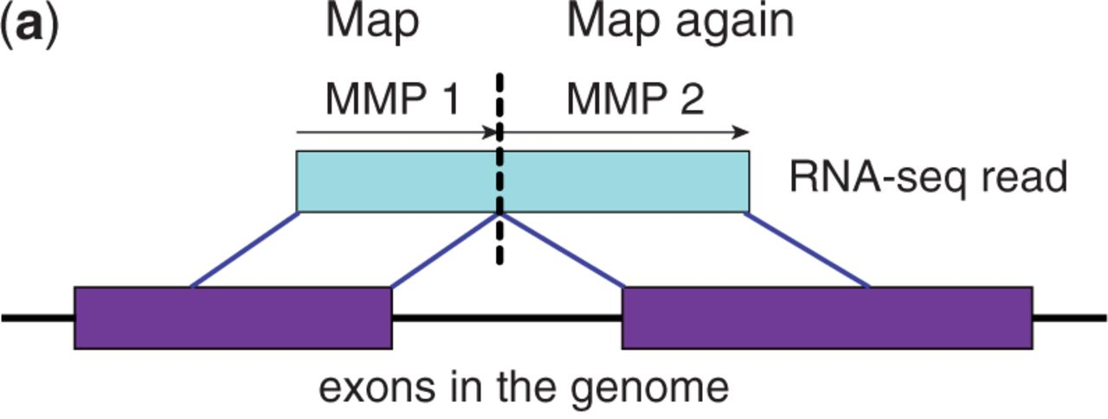

Mapping RNA sequences to the genome
Bioinformatics, Volume 29, Issue 1, January 2013, Pages 15–21, https://doi.org/10.1093/bioinformatics/bts635
The content of this slide may be subject to copyright: please see the slide notes for details.

Slide 17
Bulk RNA-sequencing workflow
Raw Data Quality Control: FastQC ↡ Adapter Trimming and Quality Filtering: Trimmomatic or Cutadapt ↡ Read Alignment: STAR or HISAT2 ↡ SAM to BAM Conversion and Sorting: SAMtools ↡ Transcript Assembly and Quantification: StringTie or featureCounts ↡ Differential Expression Analysis: DESeq2 or edgeR
Notes:
Raw Data Quality Control Tool: FastQC Purpose: Assess quality of raw FASTQ files (e.g., sequencing errors, GC content, adapter contamination). ↡
Adapter Trimming and Quality Filtering Tool: Trimmomatic or Cutadapt Purpose: Remove adapter sequences and filter low-quality reads to clean the raw data. Branch: After trimming, return to FastQC to reassess data quality. ↡
Read Alignment Tool: STAR or HISAT2 Purpose: Align the cleaned reads to a reference genome (e.g., GRCh38 for humans). ↡
SAM to BAM Conversion and Sorting Tool: SAMtools Purpose: Convert SAM file to BAM format and sort the BAM file for downstream analysis. ↡
Transcript Assembly and Quantification Tool: StringTie or featureCounts Purpose: Assemble transcripts and quantify gene or transcript-level expression from aligned reads. ↡
Differential Expression Analysis Tool: DESeq2 or edgeR Purpose: Identify differentially expressed genes between conditions by comparing gene expression counts.

Slide 18
Bulk RNA-sequencing workflow
Raw Data Quality Control: FastQC ↡ Adapter Trimming and Quality Filtering: Trimmomatic or Cutadapt ↡ Read Alignment: STAR or HISAT2 ↡ SAM to BAM Conversion and Sorting: SAMtools ↡ Transcript Assembly and Quantification: StringTie or featureCounts ↡ Differential Expression Analysis: DESeq2 or edgeR
Read Alignment & Quantification: Salmon or Kallisto
Notes:
Quantification of Transcript Abundance Tool: Salmon or Kallisto Purpose: Perform rapid, alignment-free quantification of transcript abundance from raw RNA-seq reads by directly mapping to a reference transcriptome.

Slide 19
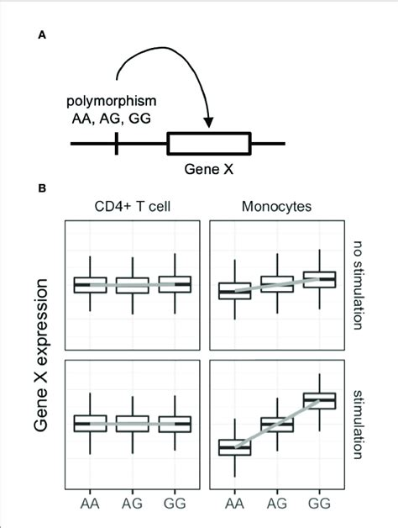
Genotyping and Gene expression: expression Quantitive Trait Loci
Nagafuchi, Y. et al. (2022). Lessons From Transcriptome Analysis of Autoimmune Diseases. Frontiers in Immunology. 13. 857269. 10.3389/fimmu.2022.857269.

Slide 20
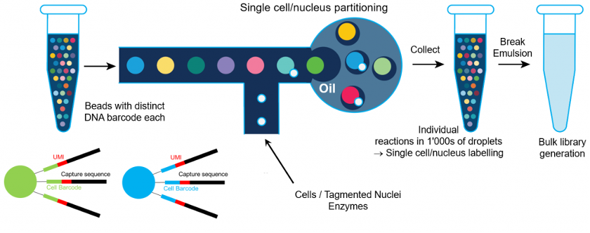
Single cell RNA-seq
Drop-seq from 10X Genomics

Slide 21
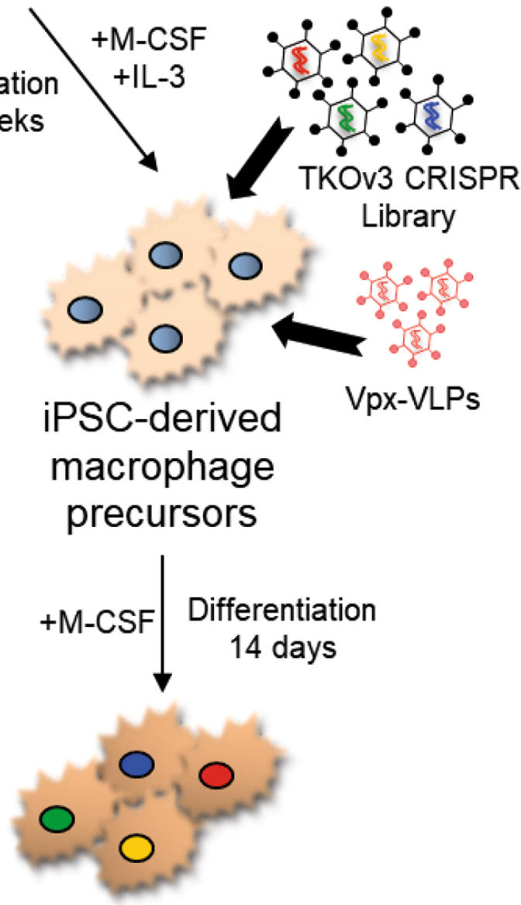
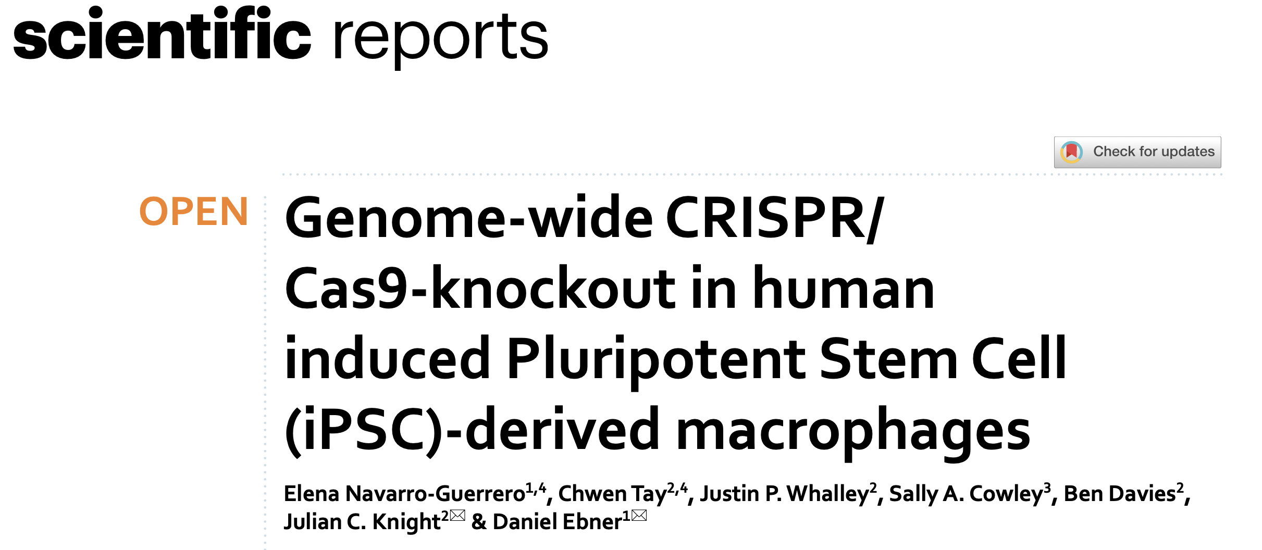
Which genes are important?

Slide 22
Environmental effects
Epigenetics
DNA -> RNA

Slide 23
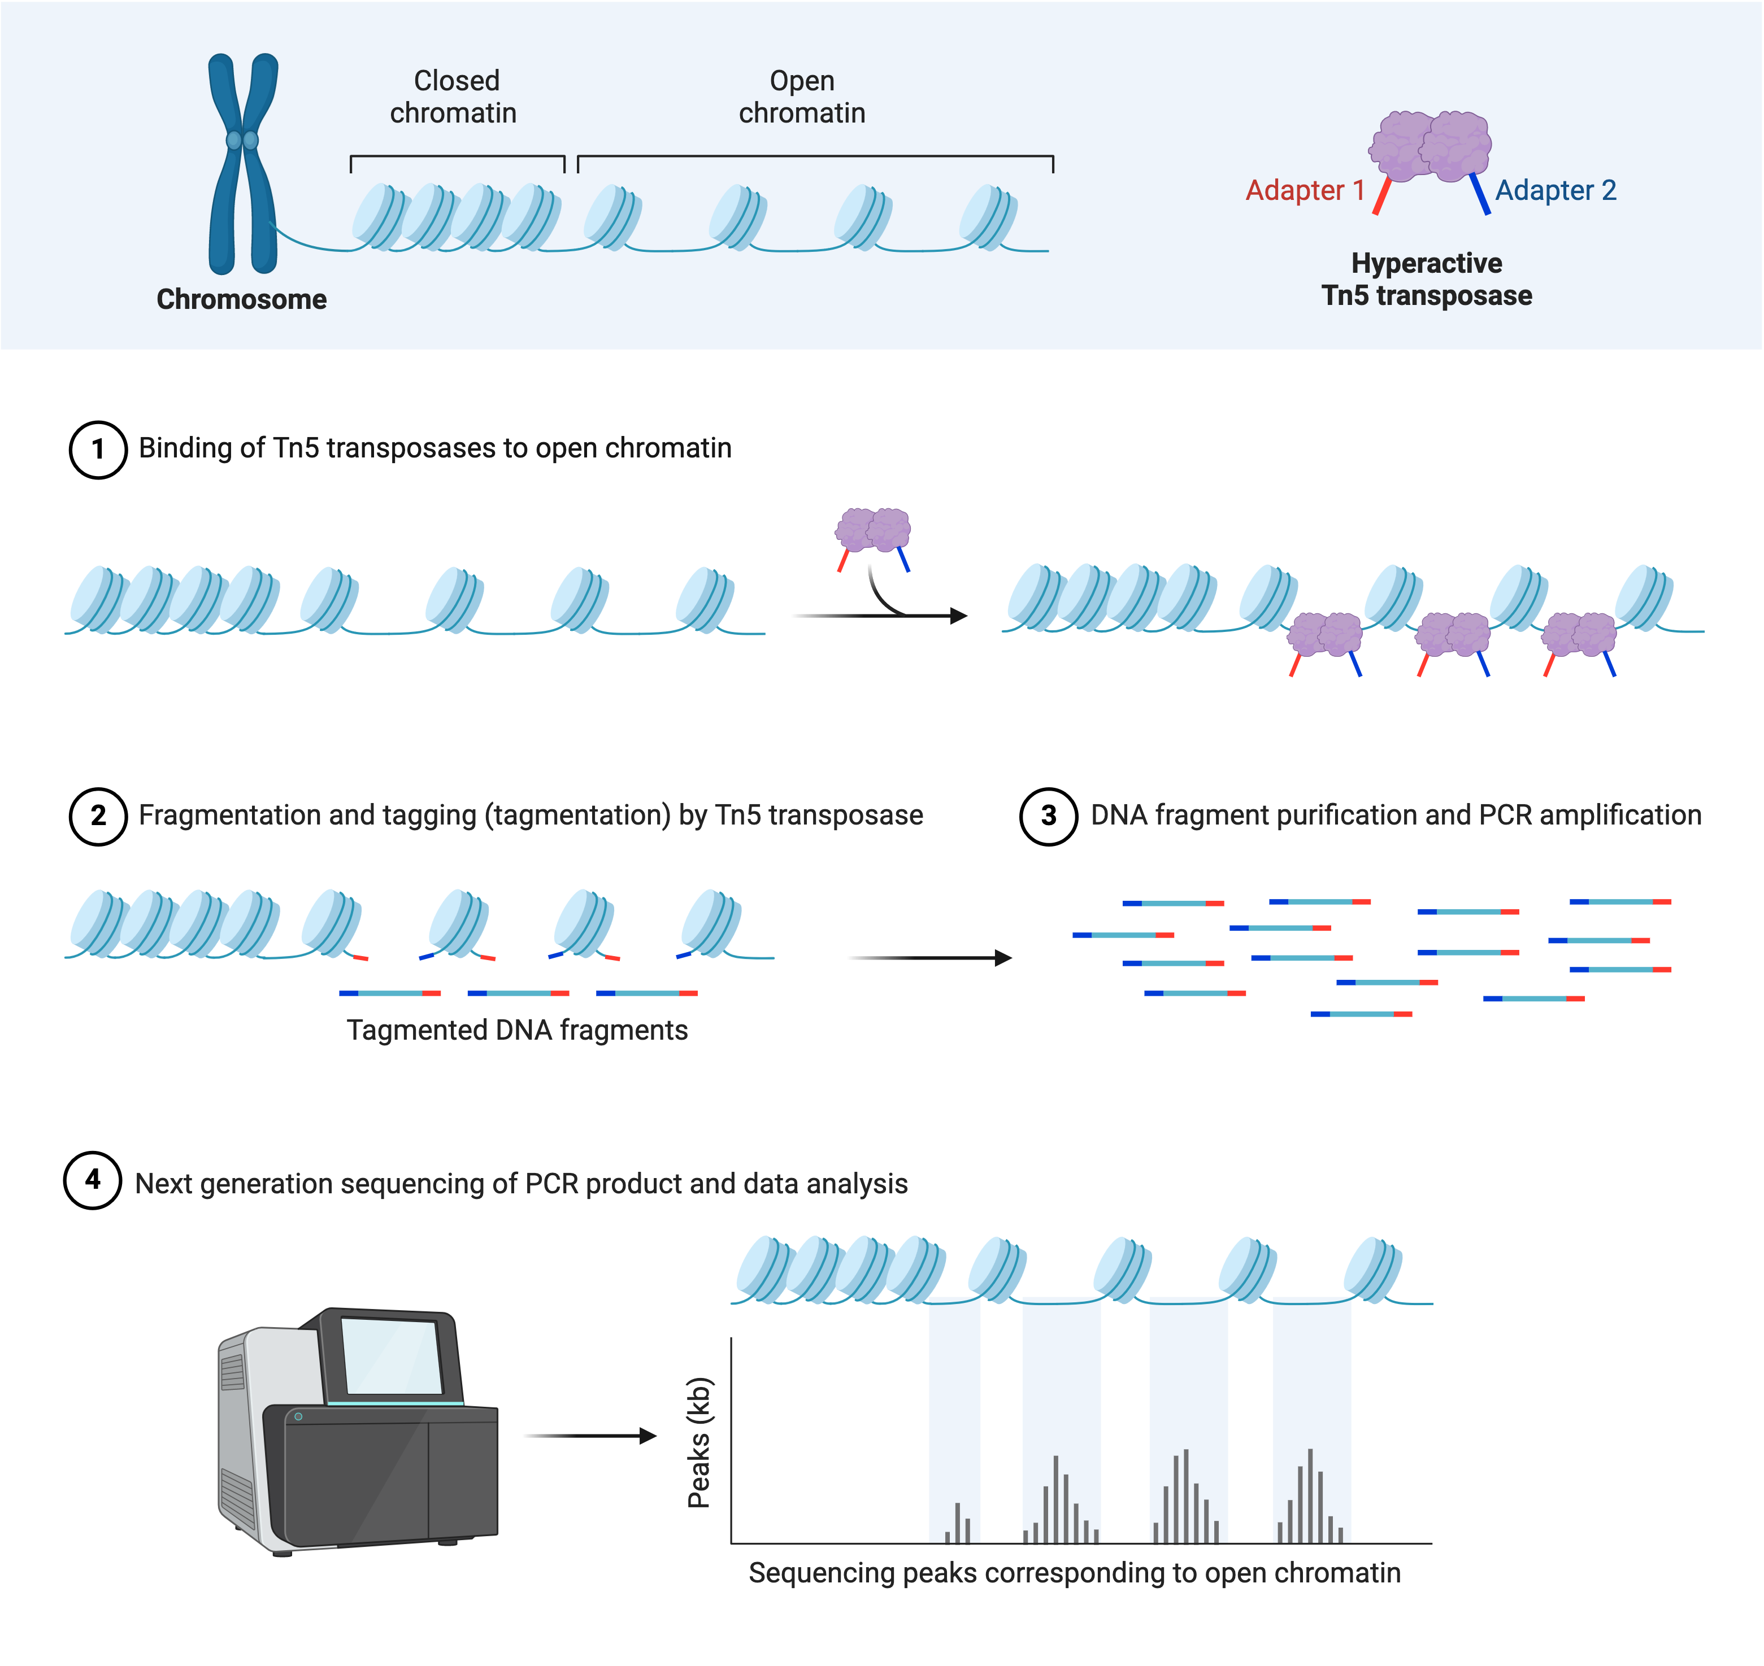
ATAC-seq: Assay for Transposase-Accessible Chromatin
Created with BioRender.com

Slide 24
ChiP or ATAC workflow
Raw Data Quality Control: FastQC ↡ Adapter Trimming and Quality Filtering: Trimmomatic or Cutadapt ↡ Read Alignment: BWA or Bowtie2 ↡ SAM to BAM Conversion and Sorting: SAMtools ↡ Duplicate Marking: Picard or SAMtools
Peak Calling: MACS2 ↡ Peak Annotation: HOMER or ChIPseeker ↡ Motif Discovery: MEME or HOMER ↡ Differential Peak Analysis: DiffBind or csaw ↡ Post-Processing QC: MultiQC ↡ Functional and Pathway Analysis: GREAT or GSEA
Notes:
ATAC-seq and ChIP-seq Workflow:
Raw Data Quality Control Tool: FastQC Purpose: Assess quality of raw FASTQ files (e.g., GC content, adapter contamination, overrepresented sequences). ↡
Adapter Trimming and Quality Filtering Tool: Trimmomatic or Cutadapt Purpose: Remove adapter sequences and filter low-quality reads from raw data. ↡
Read Alignment Tool: BWA or Bowtie2 Purpose: Align the cleaned reads to the reference genome (e.g., GRCh38 for humans), ensuring accurate mapping of open chromatin regions (ATAC-seq) or protein-bound DNA regions (ChIP-seq). ↡
SAM to BAM Conversion and Sorting Tool: SAMtools Purpose: Convert SAM to BAM, sort the aligned reads for further downstream processing. ↡
Duplicate Marking Tool: Picard or SAMtools Purpose: Mark and remove PCR duplicates to reduce bias in peak calling. ↡
Peak Calling Tool: MACS2 Purpose: Identify regions of significant enrichment in reads, corresponding to accessible chromatin regions (ATAC-seq) or protein-DNA binding sites (ChIP-seq). ↡
Peak Annotation Tool: HOMER or ChIPseeker Purpose: Annotate identified peaks with genomic features such as promoters, exons, and introns. ↡
Motif Discovery Tool: MEME or HOMER Purpose: Identify transcription factor binding motifs or other regulatory sequences within the peaks. ↡
Differential Peak Analysis Tool: DiffBind or csaw Purpose: Compare peaks across different conditions to find differentially accessible regions (ATAC-seq) or differentially bound regions (ChIP-seq). ↡
Post-Processing QC Tool: MultiQC Purpose: Summarize QC reports to ensure consistency and data quality across all samples. ↡
Functional and Pathway Analysis Tool: GREAT or GSEA Purpose: Perform functional and pathway enrichment analyses to understand the biological significance of differentially enriched regions.

Slide 25
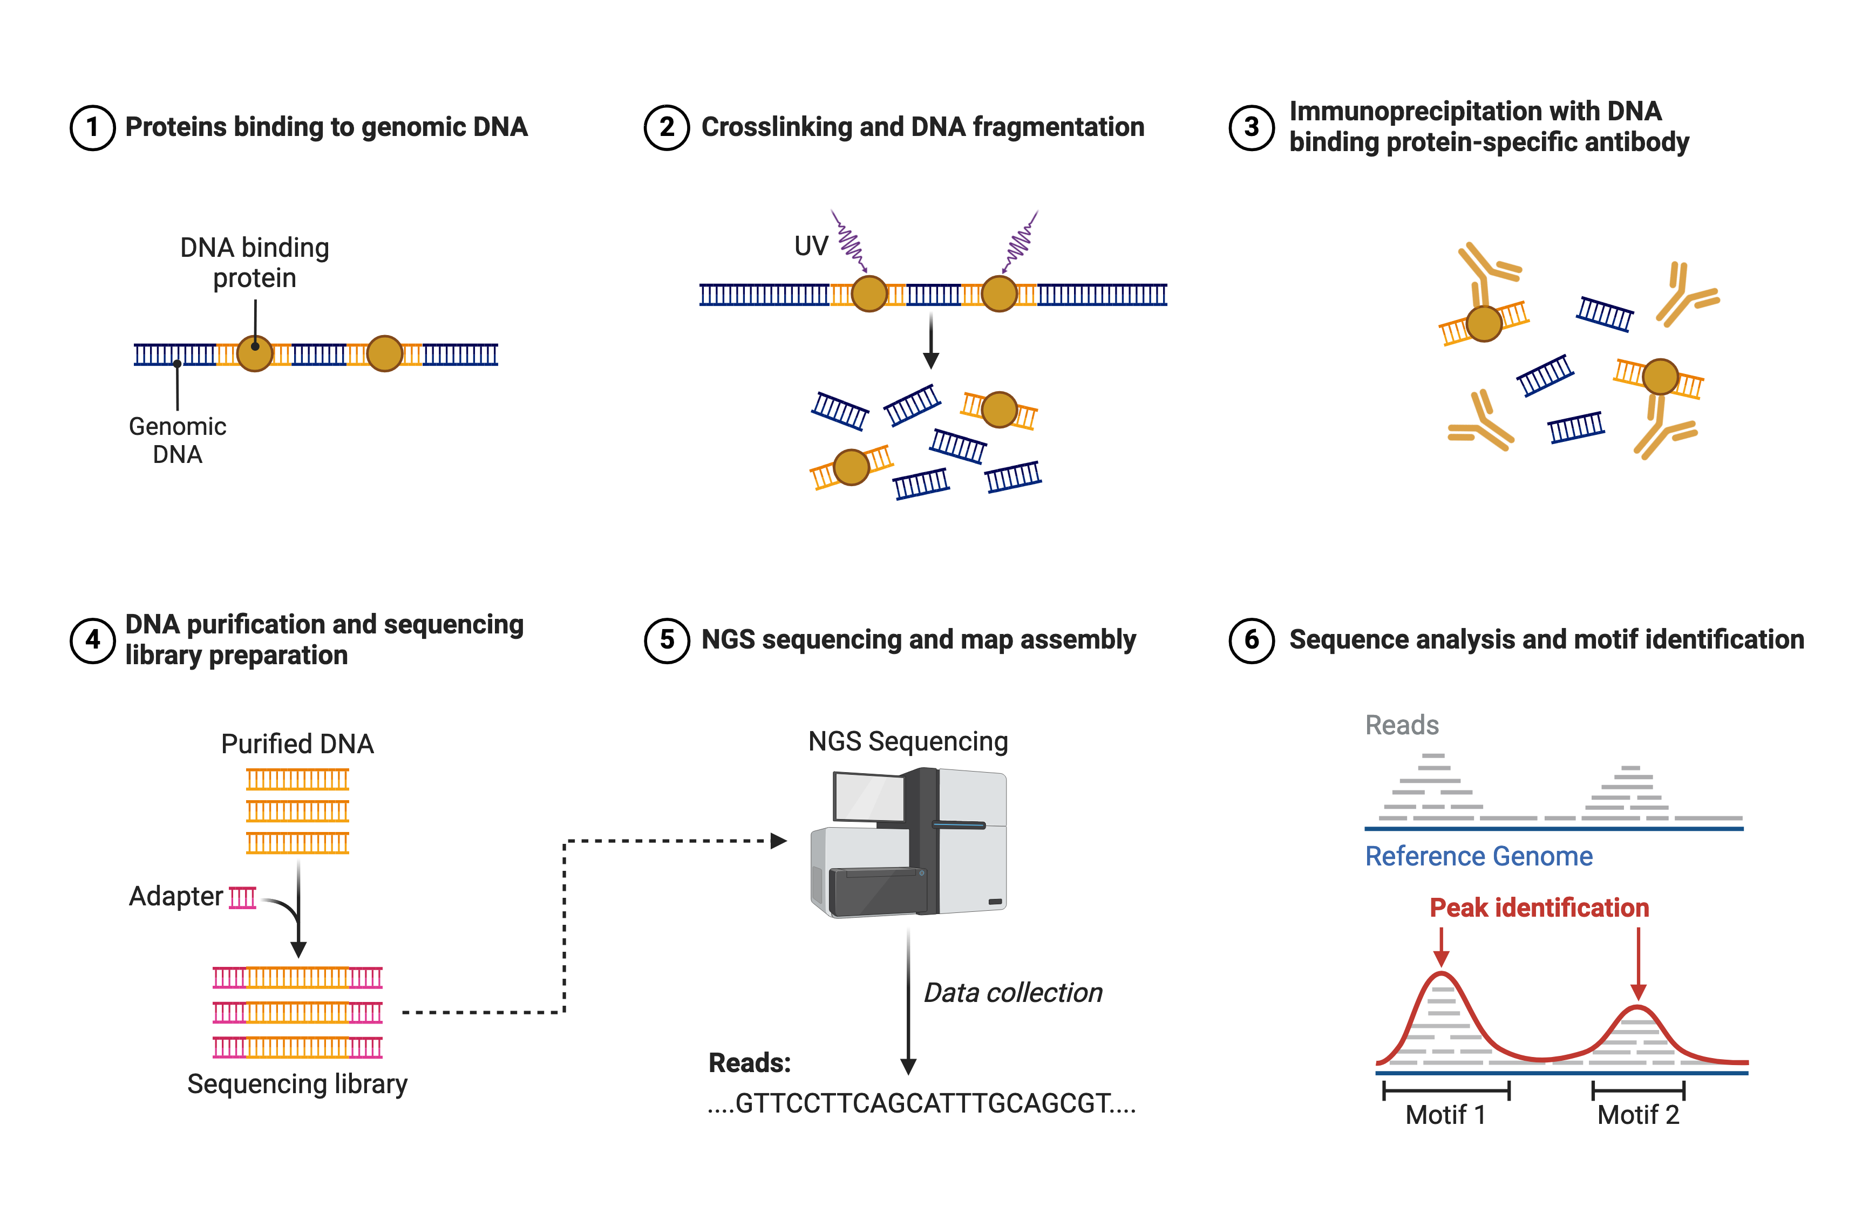
ChIP-seq
Created with BioRender.com

Slide 26
Other data
Epigenetics
DNA -> RNA -> Proteins
Metabalomics
Cellular data Lipidomics
Imaging Data
Phenotypes

Slide 27
‘omic data versus phenotypic data
Power law
Normal distribution

Slide 28
Questions?

Slide 29
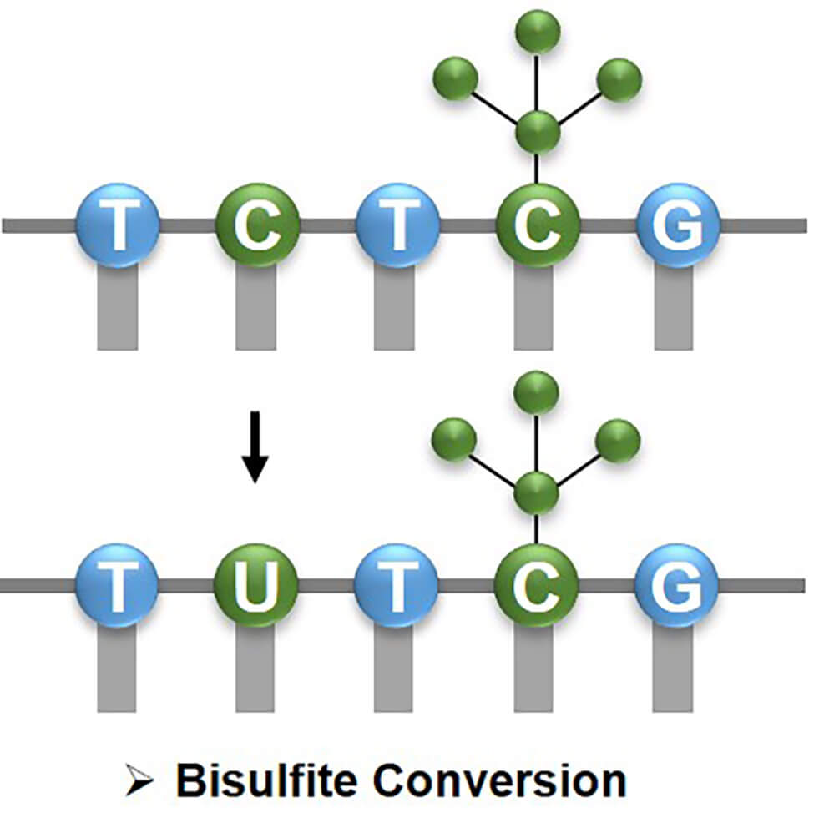
Methylation
https://www.creativebiomart.net/epigenetics/wp-content/themes/epigenetics

